Slide 1
AI TECHNICAL TASK
Msece,ece
Raymond cruzin

Slide 2
Problem Background Overview
The task at hand is to have a model for sentiment analysis that can identify the general sentiment of a given query.
Definition:
Sentiment analysis is text classification task and is an important KPI for many enterprises
This can be useful for recommendation system, decision making process
I.e. Understanding how our customers feel about a product or situation
Objective:
The model should be able to take in user input and output the sentiment and confidence score.
Evaluate the performance of the model against the test cases given
Notes:
In this presentation, I will walk you through my methodology, give a brief overview of the code, show a demo of the working model, present the test cases output with metrics such as accuracy, and suggest possible future improvements

Slide 3
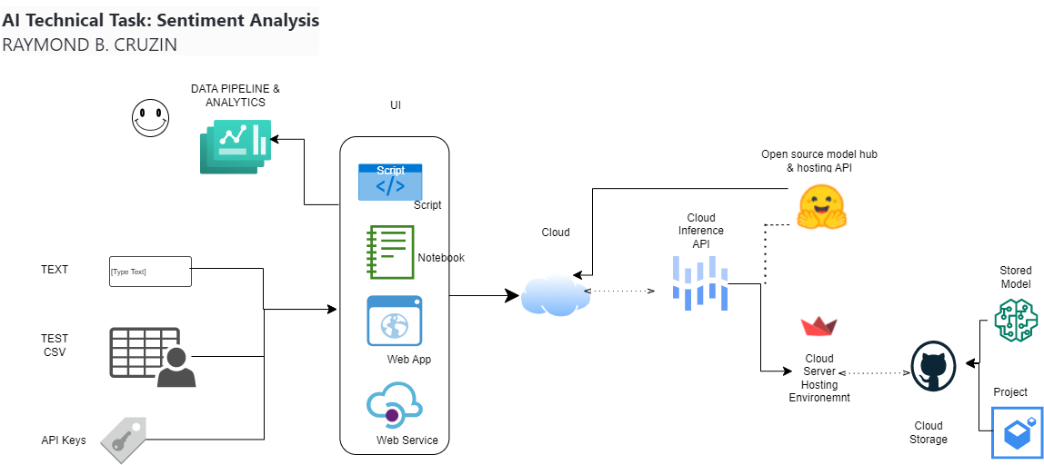
APP WORKFLOW

Slide 4

Demo
Task
The Python script should be able to take in a user input then output the sentiment and confidence score
Input
“I hate going to that restaurant”
Output
{“model_output”:“negative”,”confidence_score”: 98.42}
( Access Model via HuggingFace Inference API)

Slide 5
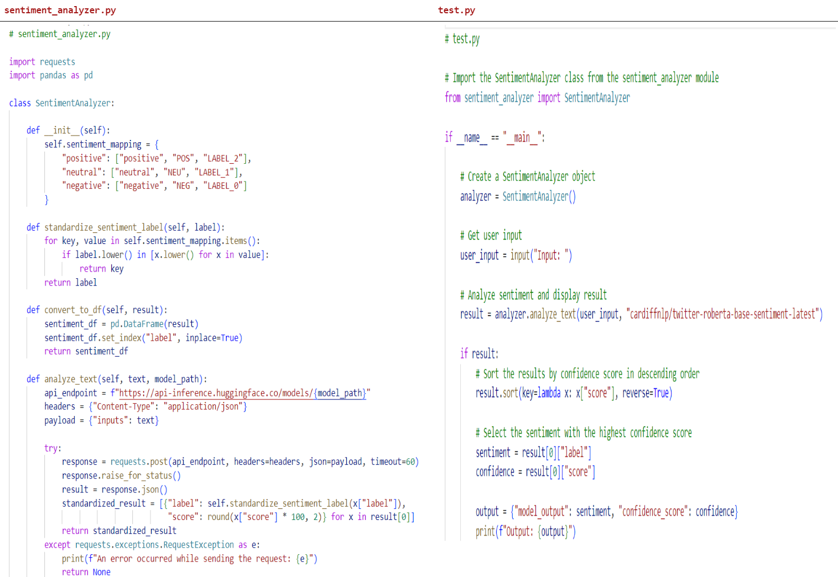
Code Review
( Access Model via HuggingFace Inference API)

Slide 6
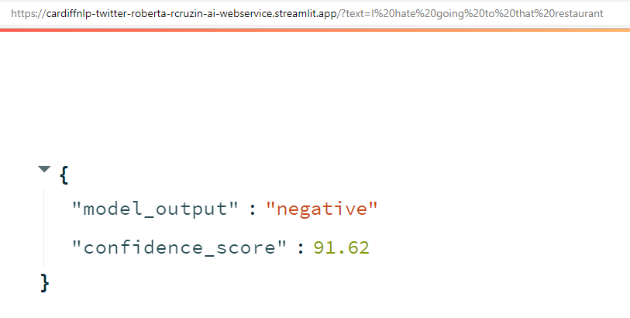
Demo
[try]: https://cardiffnlp-twitter-roberta-rcruzin-ai-webservice.streamlit.app/?text=I hate going to that restaurant
( Access Model via Streamlit Server – Model from Github Repo)

Slide 7
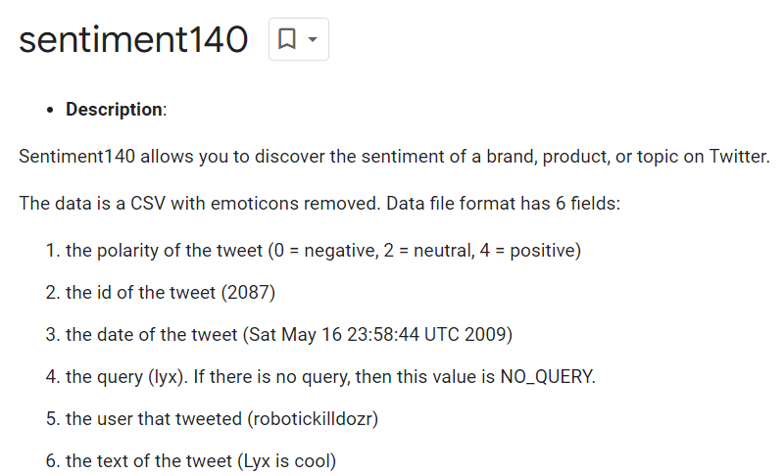
TEST CASES
Test cases is a modified version of the Sentiment140
Sentiment140 is commonly used as a benchmark dataset for evaluating sentiment analysis methods
Case Study:
sentiment140 | TensorFlow Datasets

Slide 8
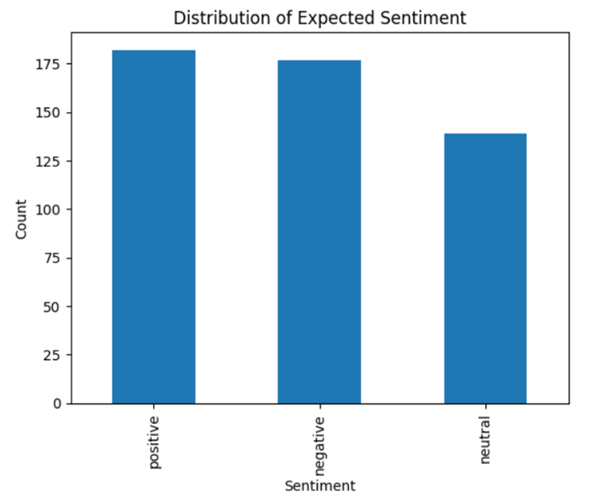
TEST CASES
The test cases given is a balanced dataset:
Instances of each class are relatively close to each other
containing 489 test cases
The problem adopts lexicon approach
positive, neutral, negative

Slide 9
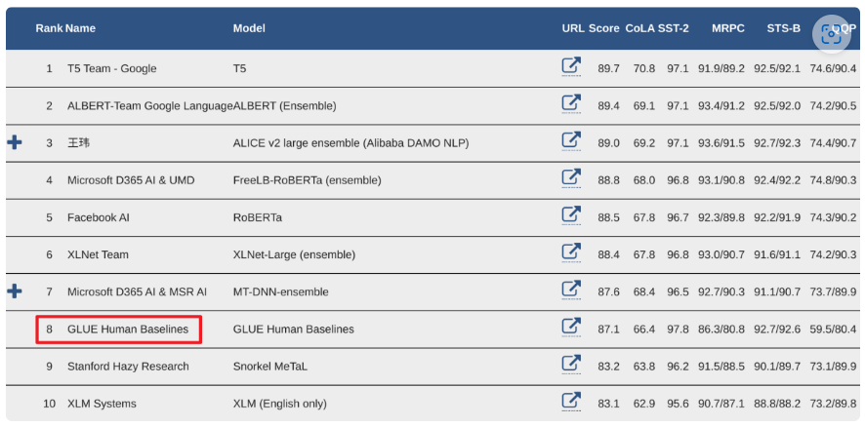
Model selection
GLUE Benchmark:
RoBERTa -is a go to model for sentiment analysis tasks
XLNet, RoBERTa, ALBERT models for Natural Language Processing (NLP) (opengenus.org)
RoBERTa has been shown to outperform both BERT and XLNet on the GLUE benchmark.
GLUE Explained: Understanding BERT Through Benchmarks · Chris McCormick (mccormickml.com)
GLUE (General Language Understanding Evaluation) has seen wide adoption and the majority of new transfer learning models publish their results on the GLUE benchmark

Slide 10
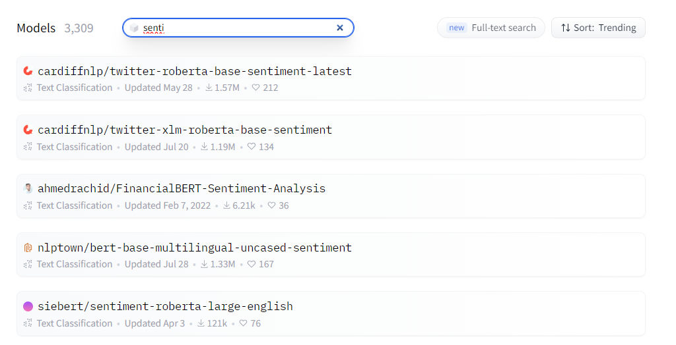
Model selection
Huggingface Community – Popular Models
RoBERTa has been consistent on top trends and most downloads

Slide 11
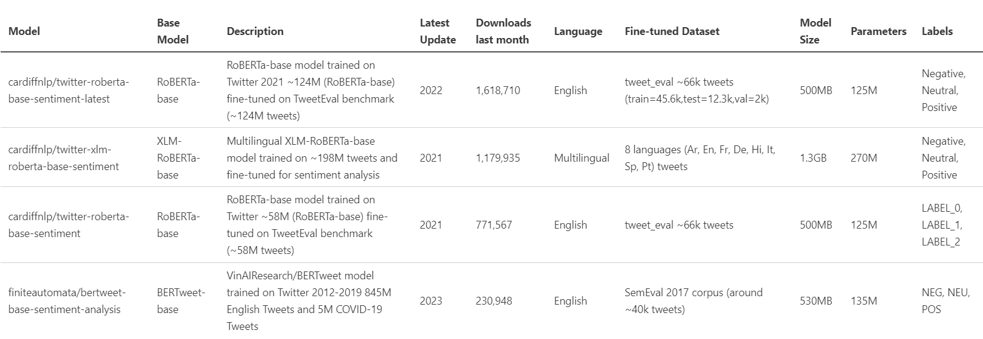
Model selection
Benchmark related open-source models based on their size, parameters, training dataset, training date

Slide 12
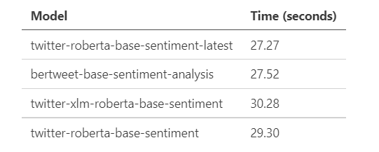
Model selection
Computational Efficiency
Save the model locally ( collab or Kaggle)
Run the test cases on same environment @ CPU

Slide 13
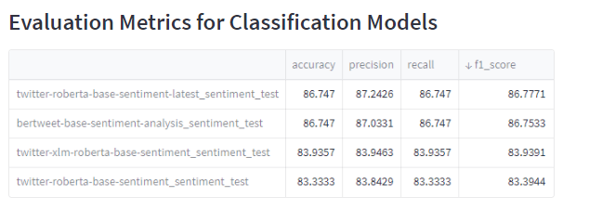
Results and Analysis
Test performance for specific dataset
[try]: https://ai-task-rcruzin-ai.streamlit.app/ ( Access Model via HuggingFace Inference API)

Slide 14
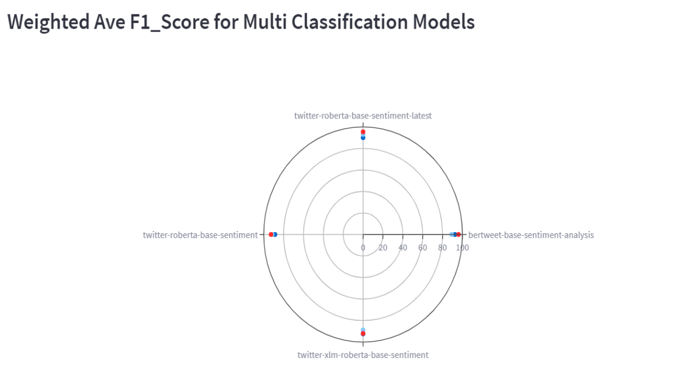
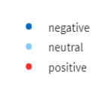
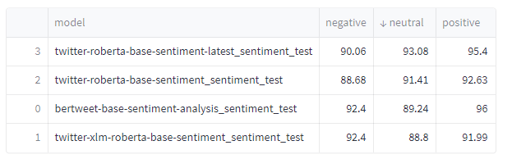
Results and Analysis
Test performance for specific dataset
[try]: https://ai-task-rcruzin-ai.streamlit.app/ ( Access Model via HuggingFace Inference API)
Notes:
Which average should I choose?
In general, if you are working with an imbalanced dataset where all classes are equally important, using the macro average would be a good choice as it treats all classes equally. It means that for our example involving the classification of airplanes, boats, and cars, we would use the macro-F1 score.
If you have an imbalanced dataset but want to assign greater contribution to classes with more examples in the dataset, then the weighted average is preferred. This is because, in weighted averaging, the contribution of each class to the F1 average is weighted by its size.

Slide 15
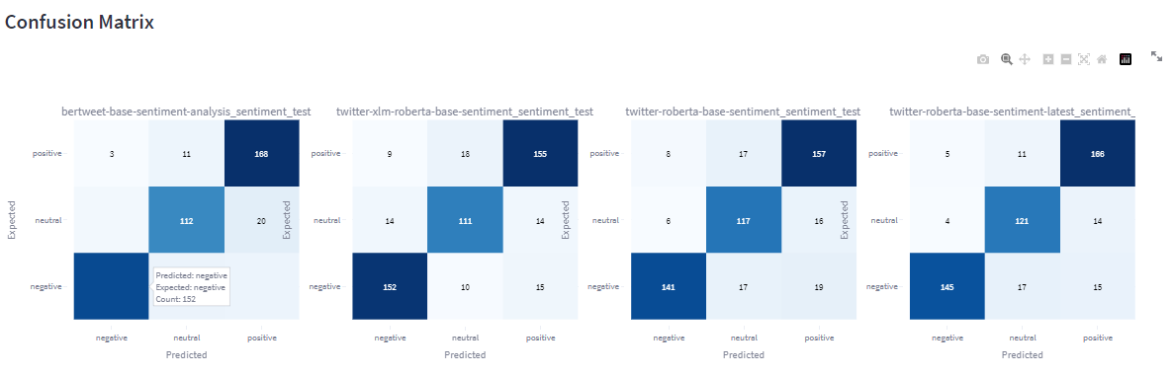
Results and Analysis
Test performance for specific dataset
[try]: https://ai-task-rcruzin-ai.streamlit.app/ ( Access Model via HuggingFace Inference API)

Slide 16
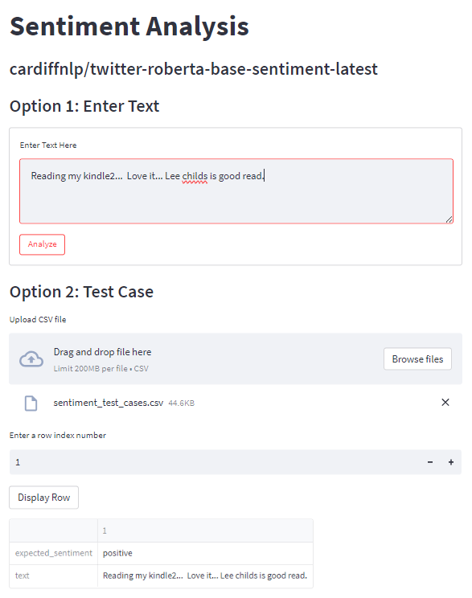

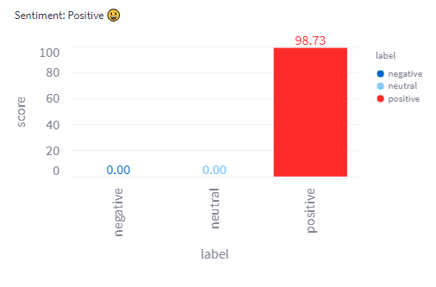
Demo
[try]: https://cardiffnlp-twitter-roberta-base-sentiment-latest-rcruzin-ai.streamlit.app/
( Access Model via Streamlit Server – Model from Github Repo)

Slide 17


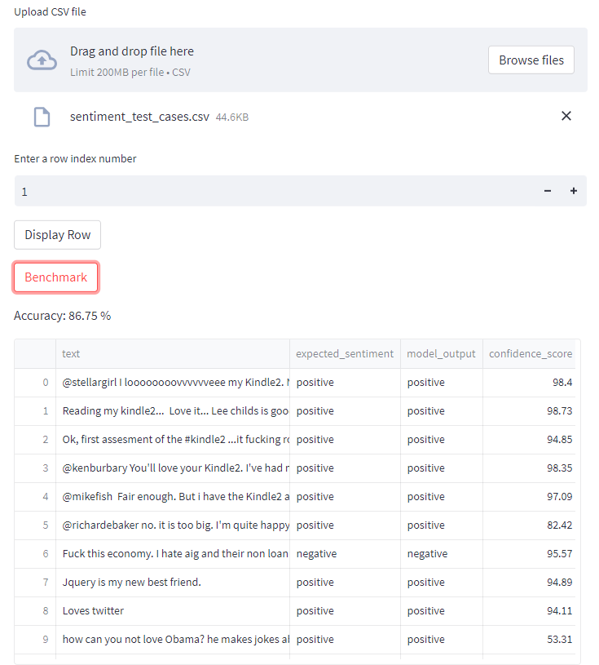
Demo
[try]: https://cardiffnlp-twitter-roberta-base-sentiment-latest-rcruzin-ai.streamlit.app/
( Access Model via Streamlit Server – Model from Github Repo)

Slide 18
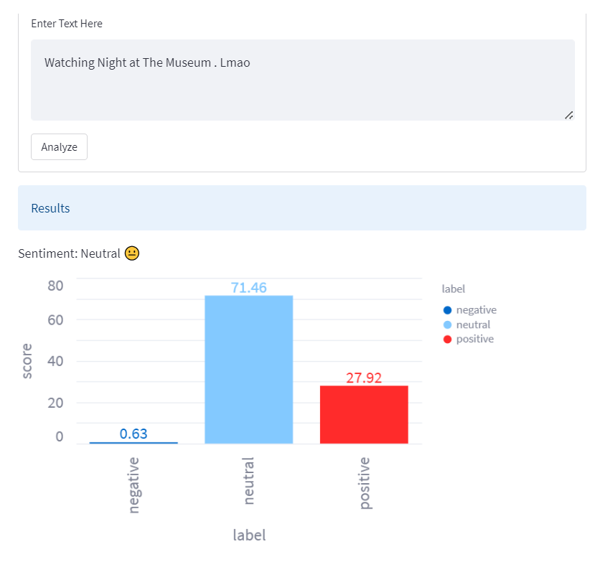
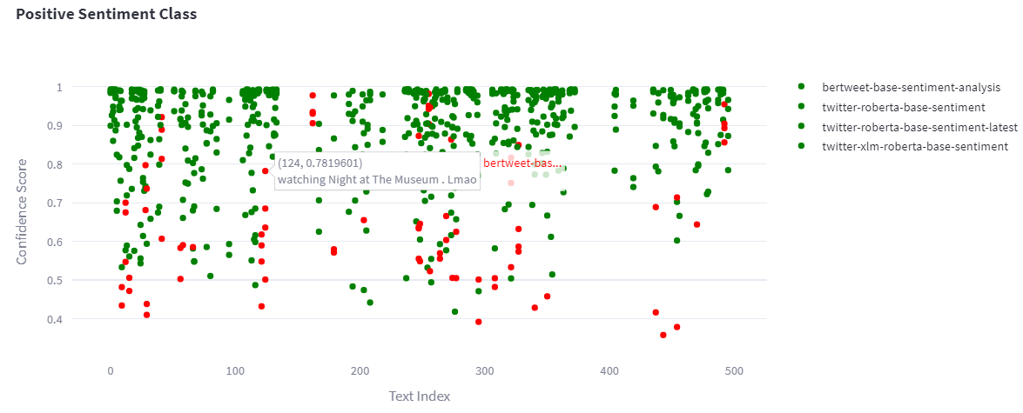
Results and Analysis
There are other test cases that all models find it difficult to predict the correct sentiment label.
Notes:
There are other test cases that all models find it difficult to predict the correct sentiment label.

Slide 19
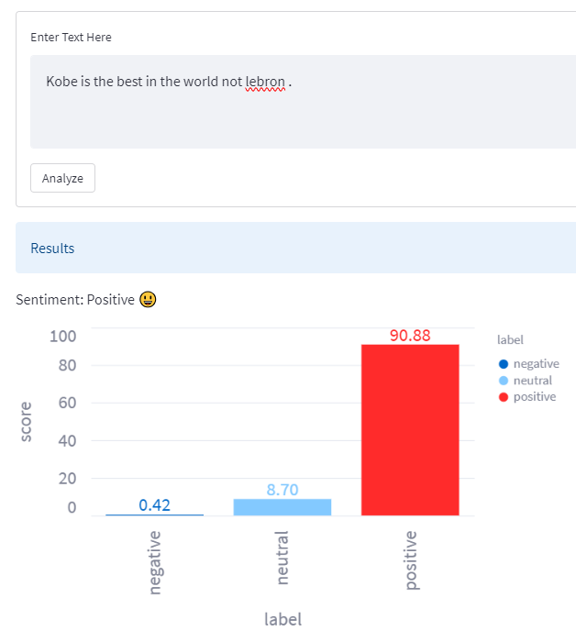
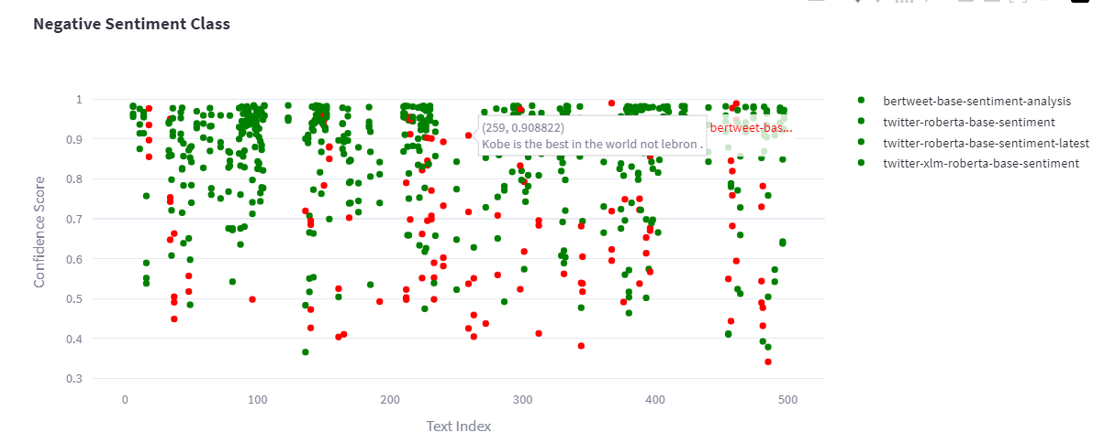
Results and Analysis

Slide 20
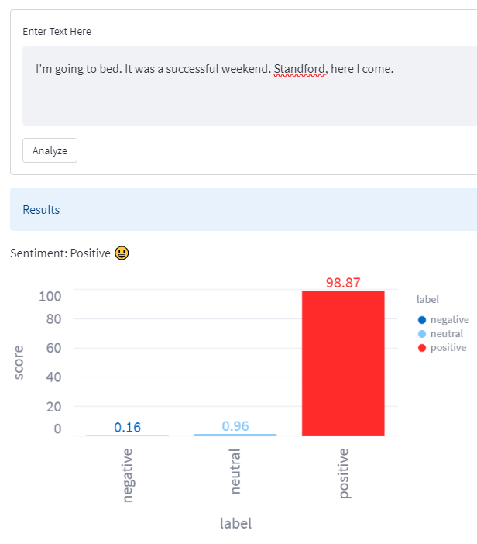
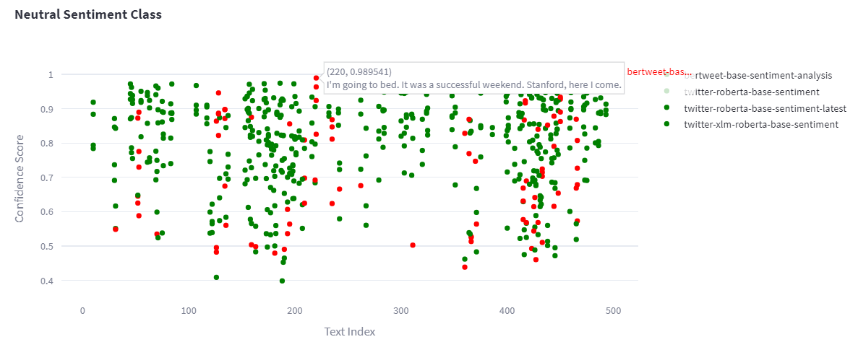
Results and Analysis

Slide 21
Possible future improvements
Sentiment analysis is a subjective problem with inherent biases, making it difficult to achieve near-perfect accuracy.
RoBERTa are good choice for sentiment analysis task,
RoBERTa is performing well when fine-tuned on large English datasets.
The twitter-xlm-roberta-base-sentiment model supports 8 languages but may not perform as well on English-only data.
The bertweet-base-sentiment-analysis model excels at identifying negative sentiment.
Both the twitter-roberta-base-sentiment-latest and bertweet-base-sentiment-analysis models are popular and widely used. 😊

Slide 22
Possible future improvements
An accuracy of 80-85% is a good benchmark for sentiment analysis models.
Fine-tuning base transformer models such as RoBERTa or BERTweet on the Sentiment140 dataset can improve accuracy for specific dataset.
Adopting semantic similarity vectors can help handle emoji or emoticons.
Reinforcement learning and fine-tuning on the Sentiment140 dataset can also improve performance.
A sample notebook on how to fine tune the model
https://www.kaggle.com/code/nguyncaoduy/twitter-sentiment-analysis-roberta-96-accuracy/notebook

Slide 23
Conclusion
We have developed a methodology for identifying the sentiment of a given query using a hybrid lexicon approach and benchmarking related open-source models.
Our analysis shows that the `twitter-roberta-base-sentiment-latest` model has the highest overall performance in terms of accuracy, precision, recall, and F1 score.
While achieving near-perfect accuracy is difficult due to the subjective nature of sentiment analysis,
fine-tuning base transformer models such as RoBERTa or BERTweet on the Sentiment140 dataset can improve accuracy.
Our project can be run locally as a script or on a notebook, or deployed in the cloud as a web application for easy access and scalability.

Slide 24
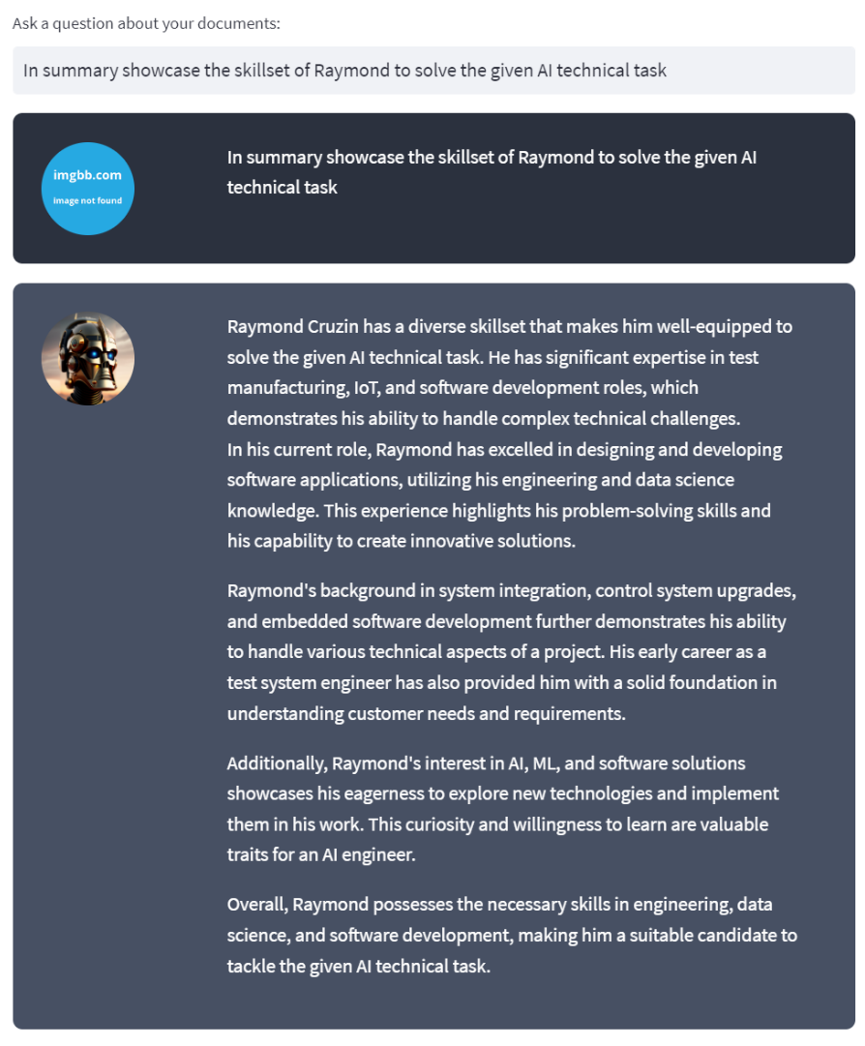
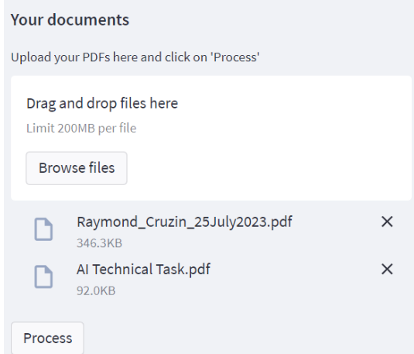
Personal Projects
Chat AI application uses semantic similarity, open ai or open source embeddings, vector databasesm and langchain and other tools to allow users to chat with their documents.
Users can use the openai service to check if a given document, such as Raymond_Cruzin.pdf, can perform a given task, such as the Ai_Technical_Task.pdf. The application allows users to process documents and ask questions.

Slide 25
THANK YOU 😊

